Slide 1

Denoising Autoencoder to Fill Missing Values
Max Wienandts
CSCI E-82 Advanced Machine Learning, Data Mining, and Artificial Intelligence
Fall 2023
Harvard Extension School

Slide 2
Introduction
Denoising Autoencoder can be used to reconstruct damaged data.
But…
Does it work with all kind of data?
Is it superior to other techniques?
Performance comparison for 3 problems:
Only continuous variables;
Only categorical variables; and
Continuous and categorical variables.
How to implement autoencoder for each of these situations.
Github: https://github.com/MaxWienandts/Denoising_Autoencoder_to_Missing_Data_Imputation/tree/main

Slide 3
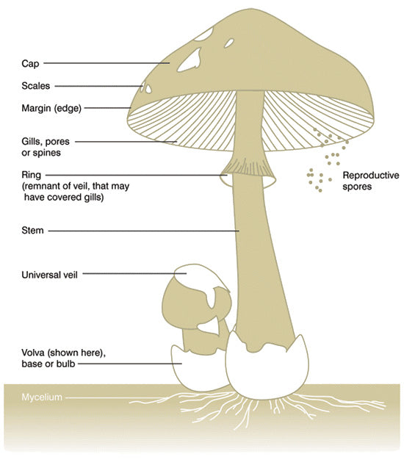
The Data
Wine Quality (https://archive.ics.uci.edu/dataset/186/wine+quality)
Problem: Prediction of wine type (red or white);
Observations: 6,497;
Variables: 11 physicochemical continuous variables.
Mushroom Dataset (https://archive.ics.uci.edu/dataset/848/secondary+mushroom+dataset)
Problem: Prediction if a mushroom is edible or poisonous;
Observations: 61,069;
Variables: 20 physical characteristics:
3 continuous;
17 categorical.
Two models:
Using only categorical variables;
Using all variables.

Slide 4
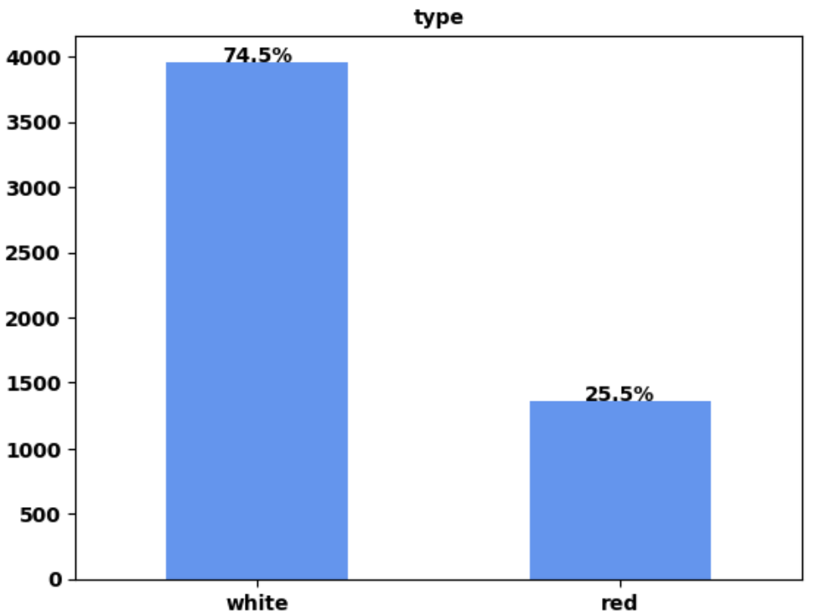
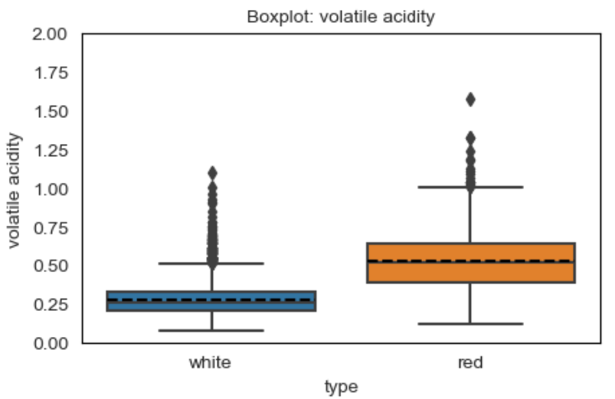
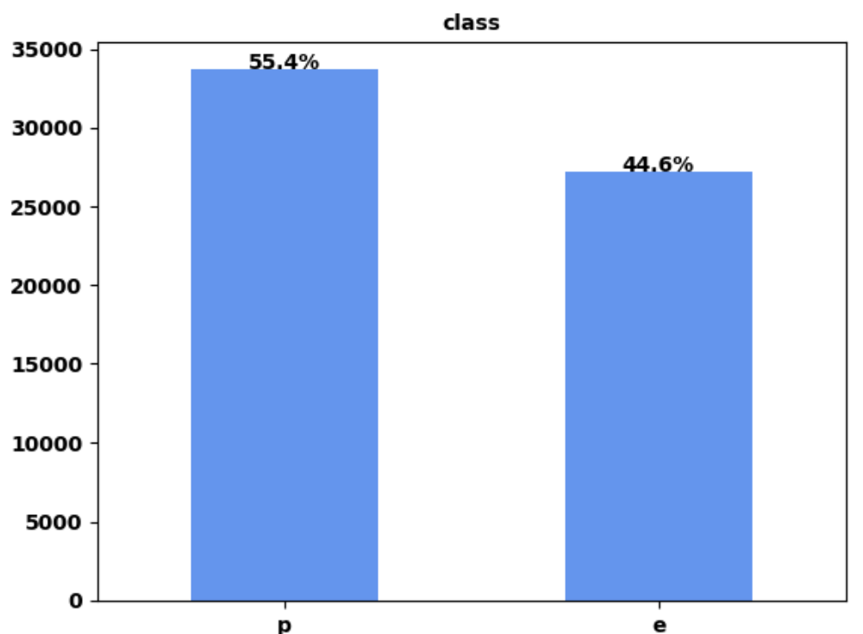
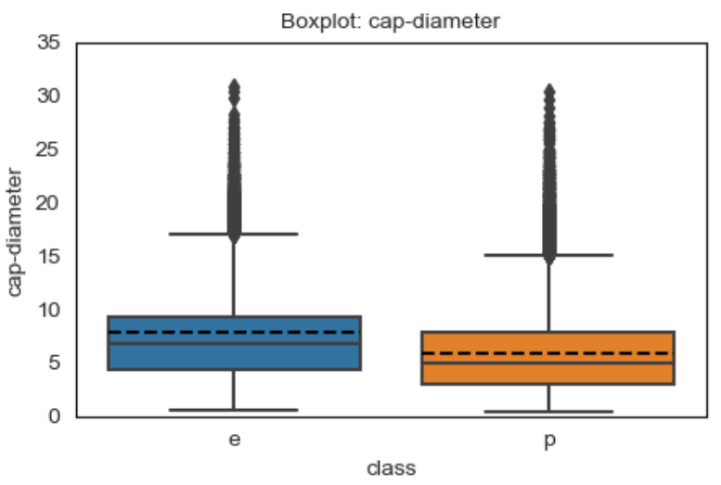
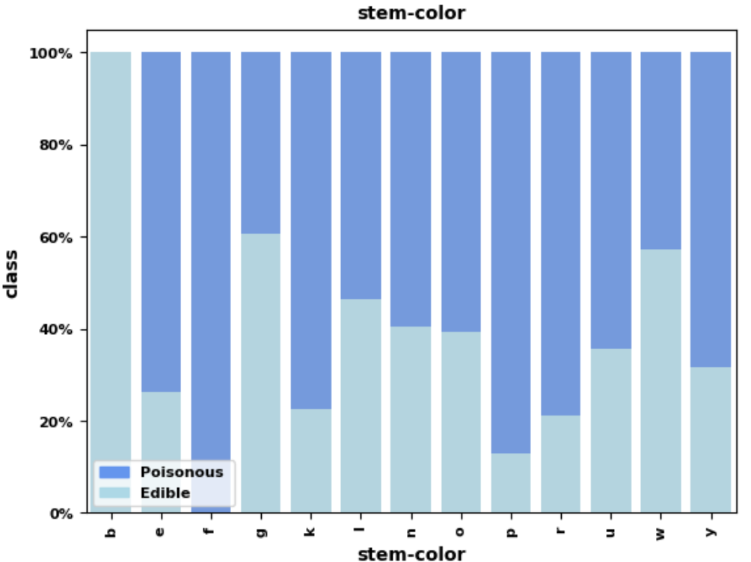
Exploratory Data Analysis
Wine dataset:
Wine\1 EDA Denoising Autoencoder.ipynb;
No missing values.
Mushroom dataset:
Mushroom\1 EDA Denoising Autoencoder.ipynb;
There are missing values when a mushroom does not have a characteristic, i.e., not all mushroom have a veil.
B = buff
F = none

Slide 5
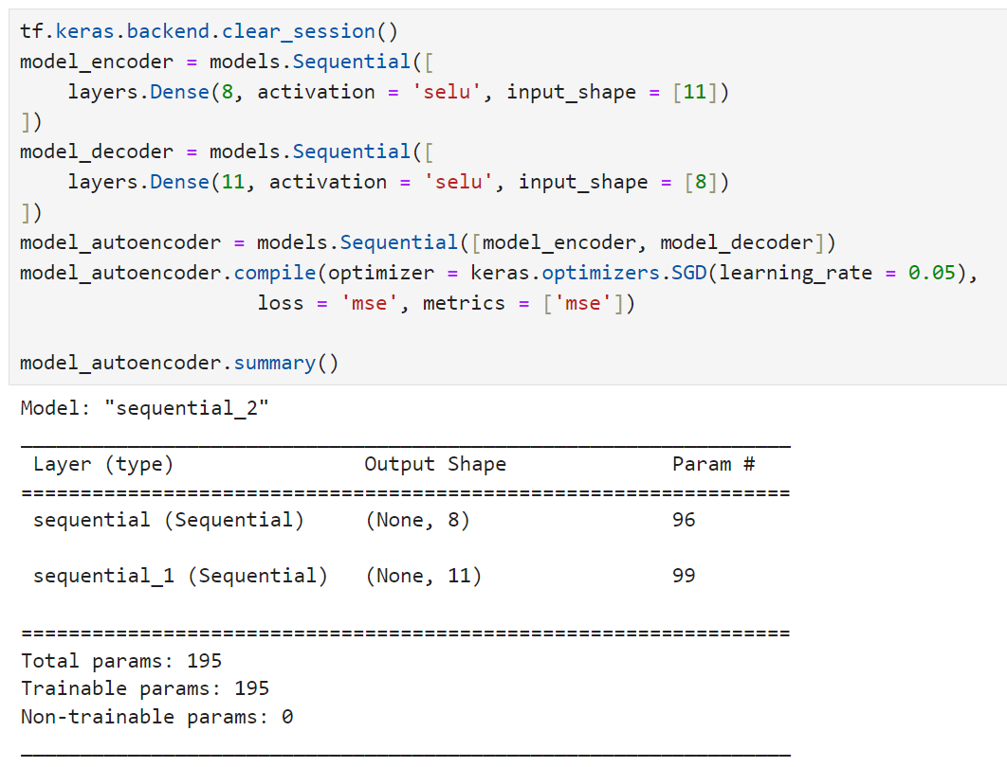
Autoencoders
Wine dataset:
Wine\2 Denoising Autoencoder.ipynb
Coding: 8
Activation: SeLU
Loss function: Mean Squared Error

Slide 6
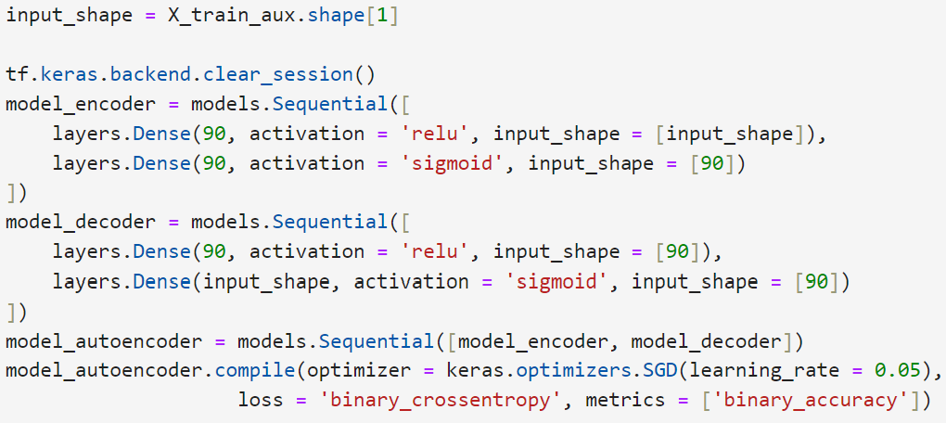
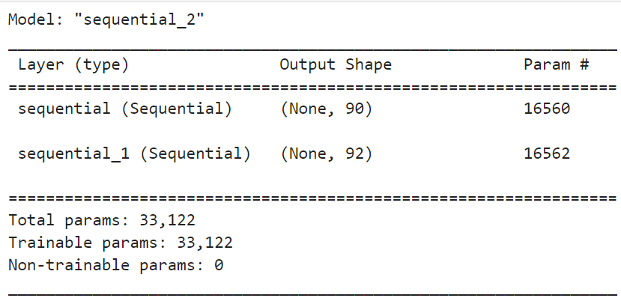
Autoencoders
Mushroom dataset (only categorical variables):
Mushroom \2 Denoising Autoencoder only Category.ipynb
Coding: 90 (there are 92 dummies in total)
Activation: ReLU and sigmoid (It is a good idea to map results to 0 and 1)
Loss function: Binary Cross Entropy

Slide 7
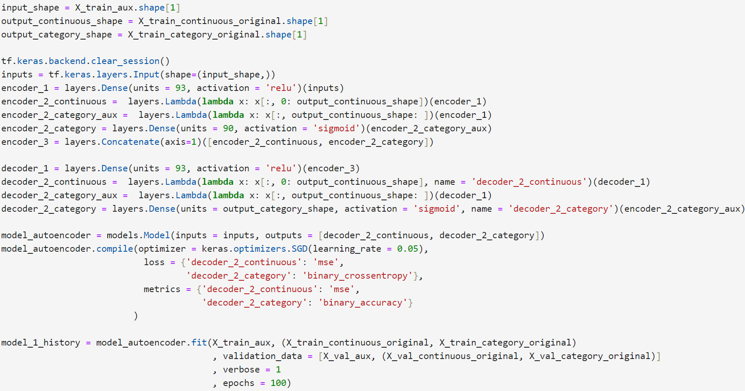
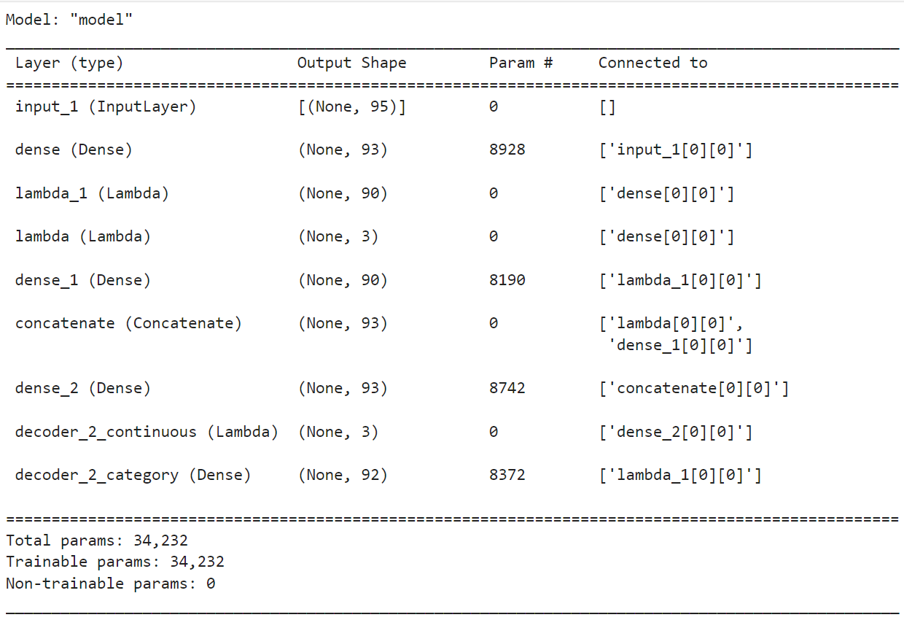
Autoencoders
Mushroom dataset (categorical and continuous variables):
Mushroom \2 Denoising Autoencoder Continuous and category.ipynb
Coding: 93 (there are 92 dummies plus 3 continuous variables)
Activation: ReLU and sigmoid (It is a good idea to map results to 0 and 1)
Loss function: Mean Squared Error and Binary Cross Entropy

Slide 8
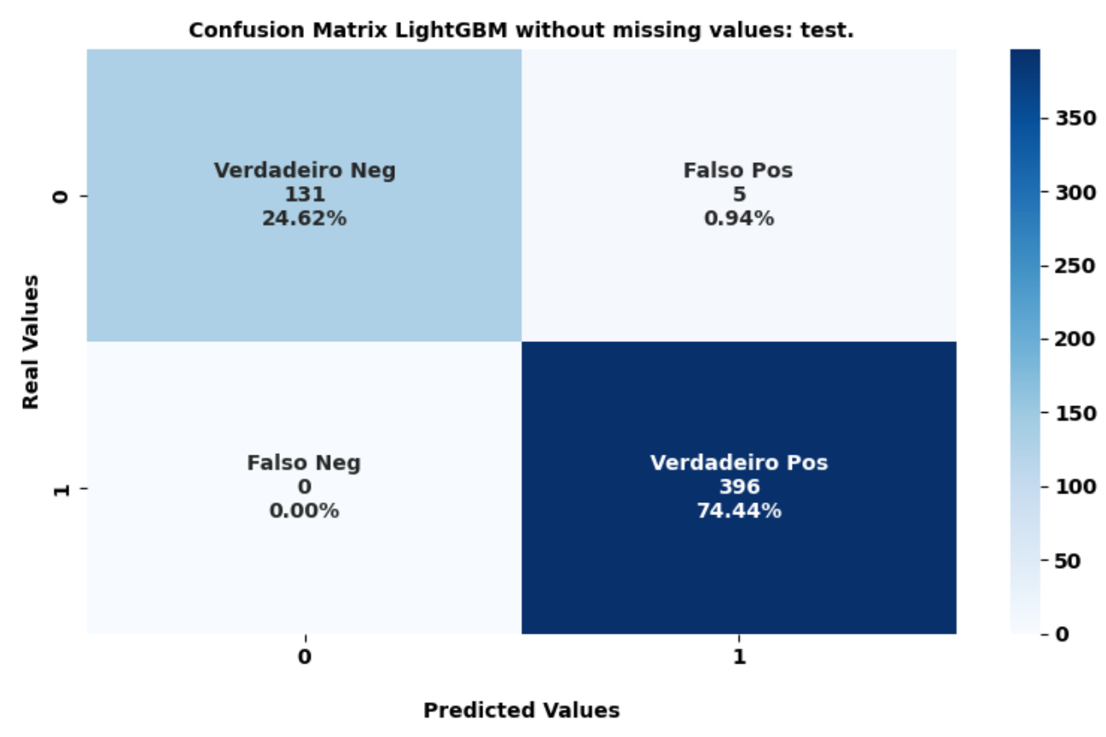
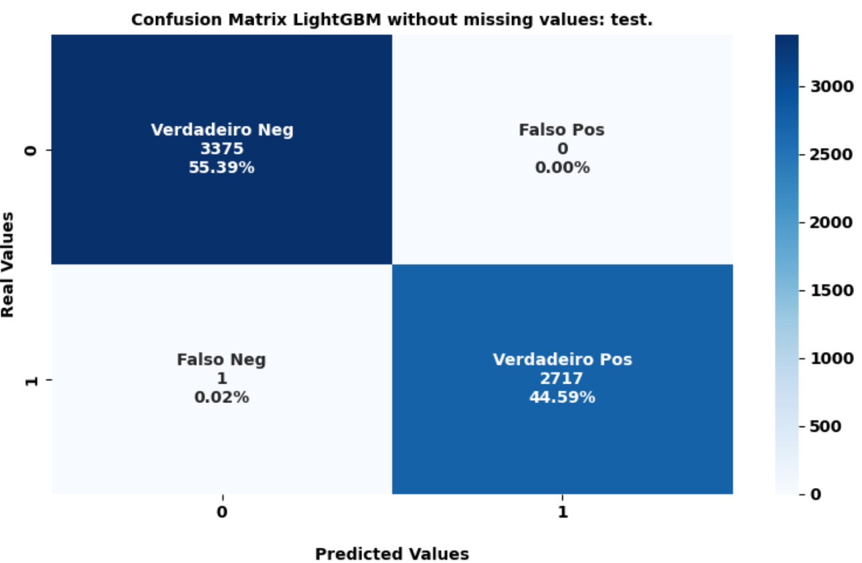
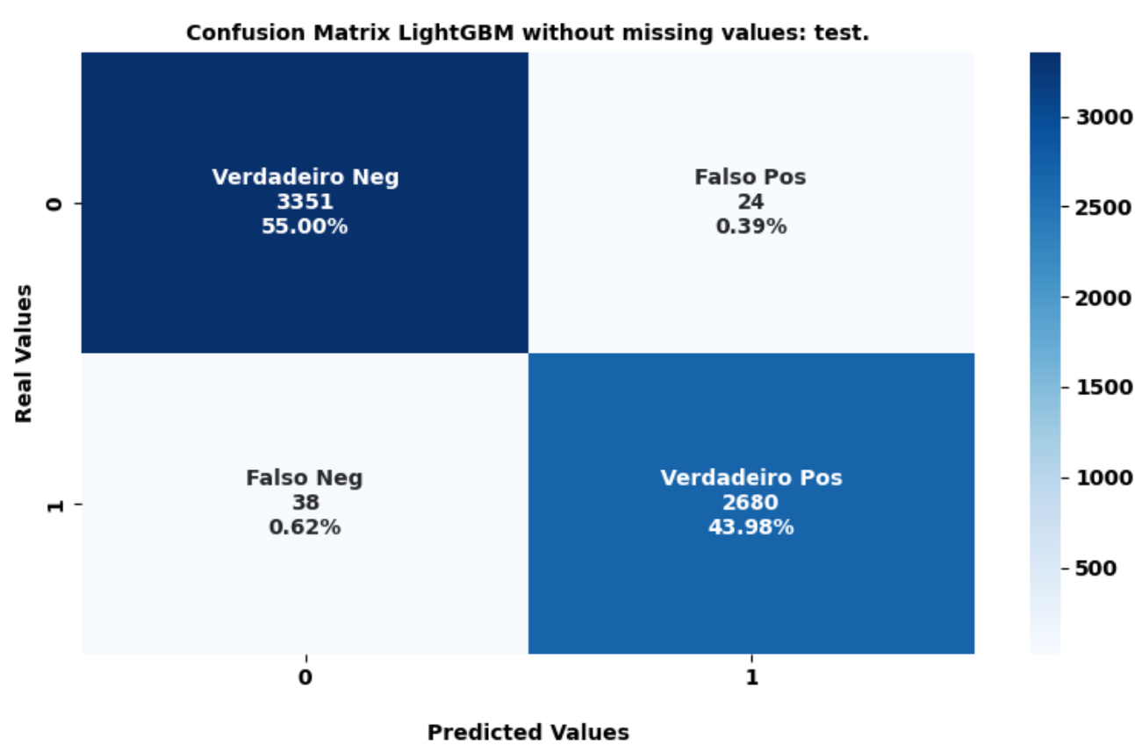
LightGBM without missing
Wine:
Wine\2 Denoising Autoencoder.ipynb
Test set represent 10% of the data unseen by the model
Accuracy: 99%
Mushroom (only categorical variables):
Mushroom \2 Denoising Autoencoder only Category.ipynb
Mushroom \2 Denoising Autoencoder Continuous and category.ipynb
Test set represent 10% of the data unseen by the model
Accuracy: 99%
Only categorical variables
Categorical and Continuous variables

Slide 9
Missing Values Simulation
18 datasets for each problem were created
Each dataset with a different proportion of randomly fabricated missing values. Proportions used: .05, .10, .15, .20, .25, .30, .35, .40, .45, .50, .55, .60, .65, .70, .75, .80, .85, .90
For both mushroom studies, the missing values were only created in the categorical variables. First, the variables were one-hot encoded. After, each value was randomly set to zero.

Slide 10
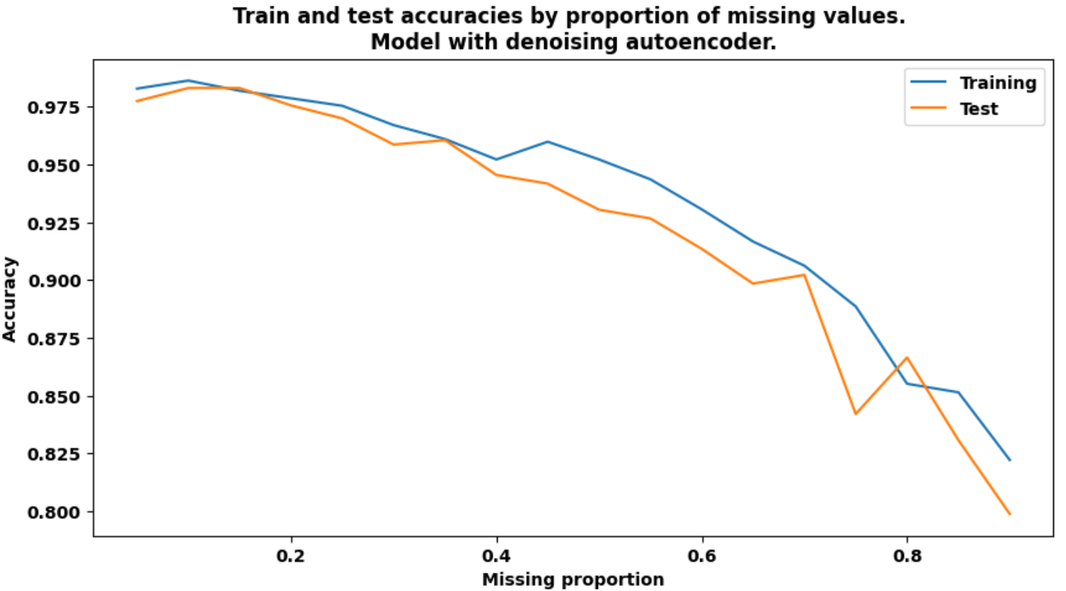
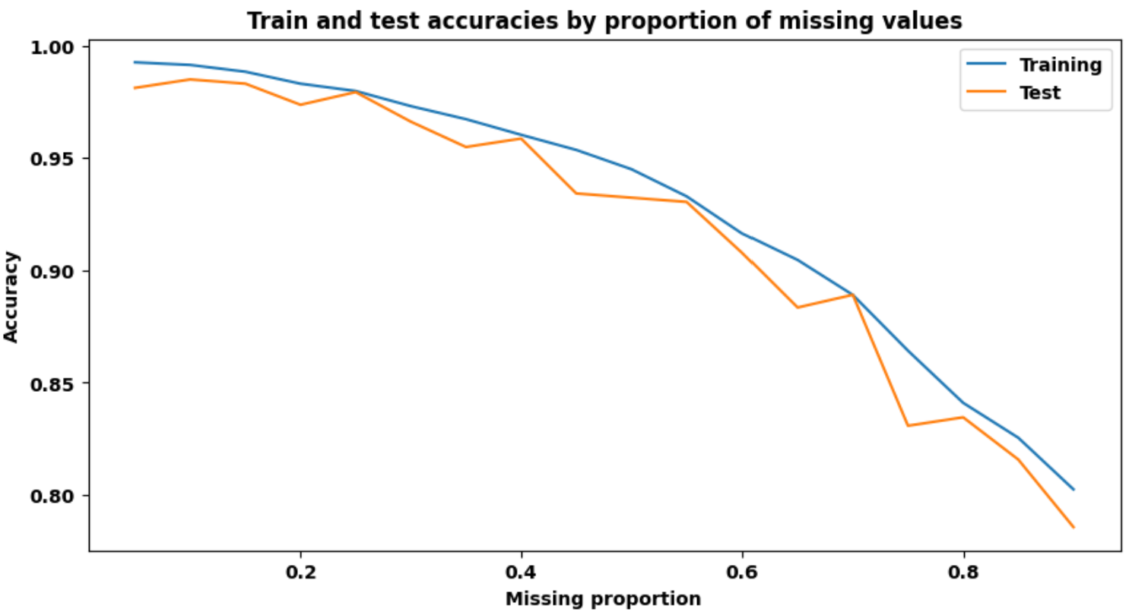
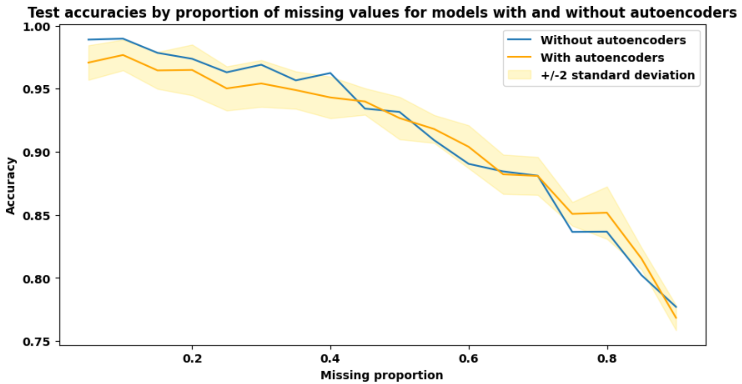
Results: Wine Dataset
LightGBM without denoising autoencoder:
Missing values were filled with the median.
LightGBM with denoising autoencoder:
Comparison with and without autoencoder using bootstrap.

Slide 11
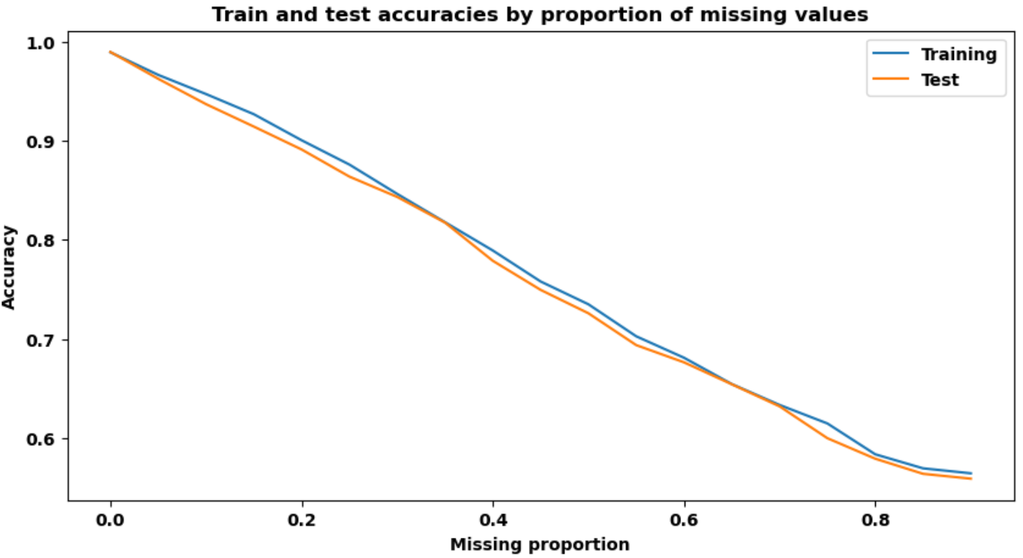
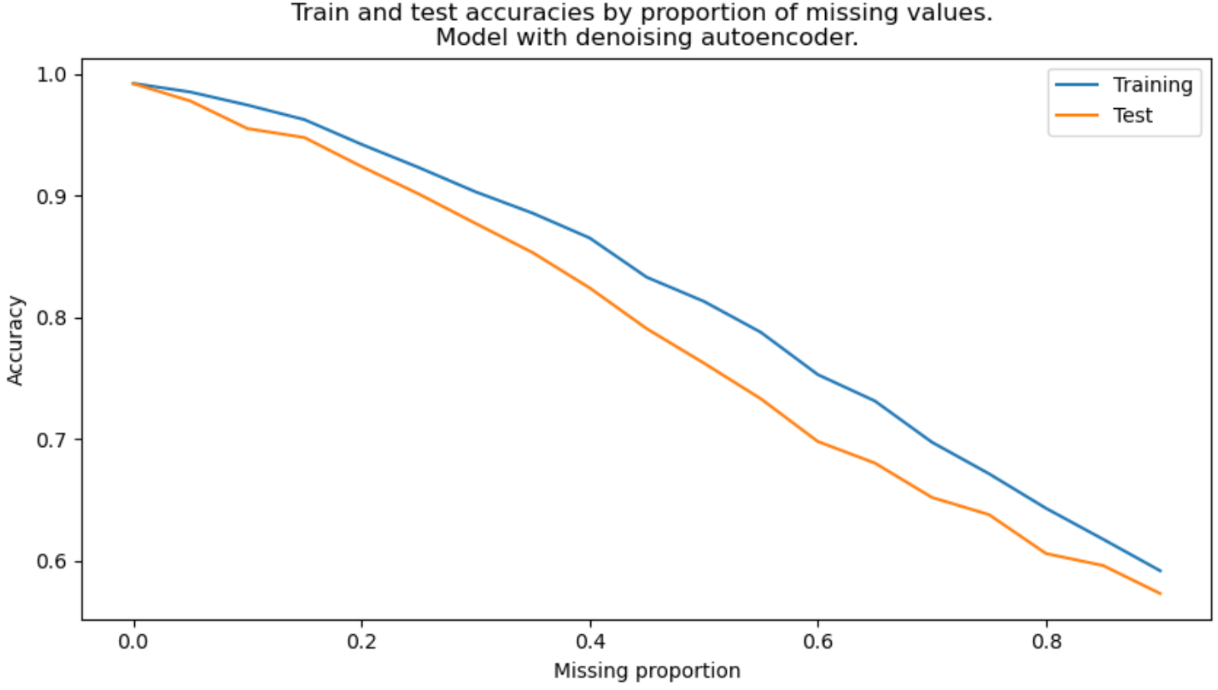
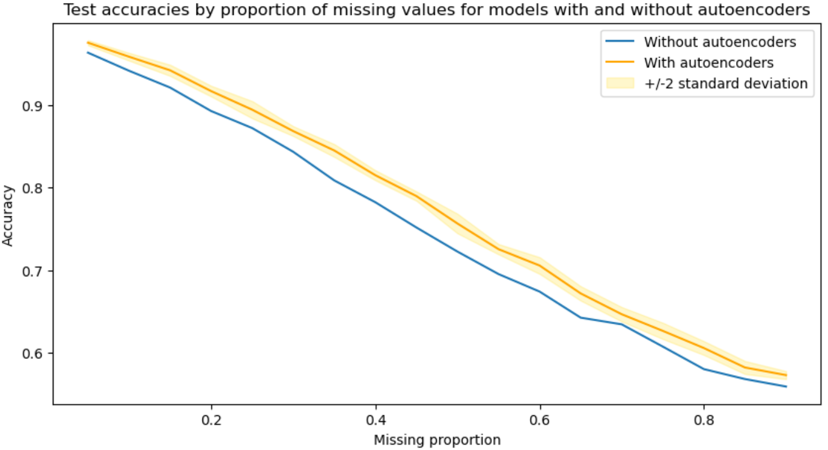
Results: Mushroom Only Categoric
LightGBM without denoising autoencoder:
Missing values were filled with the median.
LightGBM with denoising autoencoder:
Comparison with and without autoencoder.

Slide 12
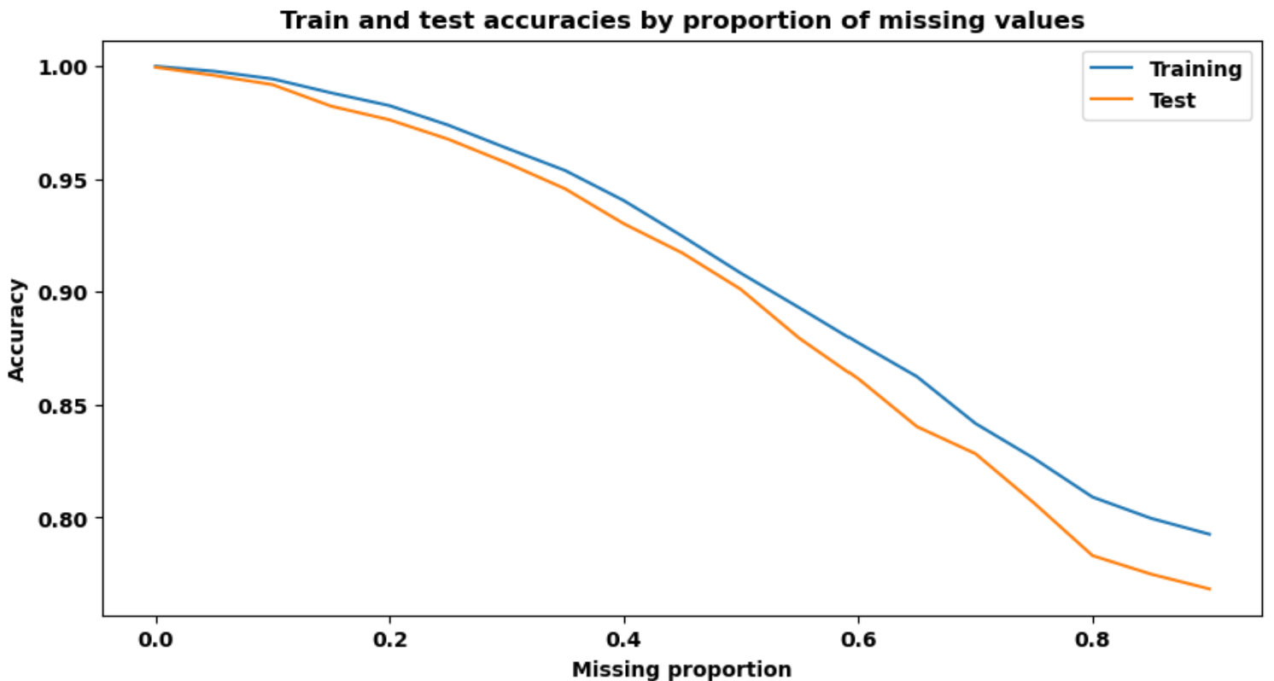
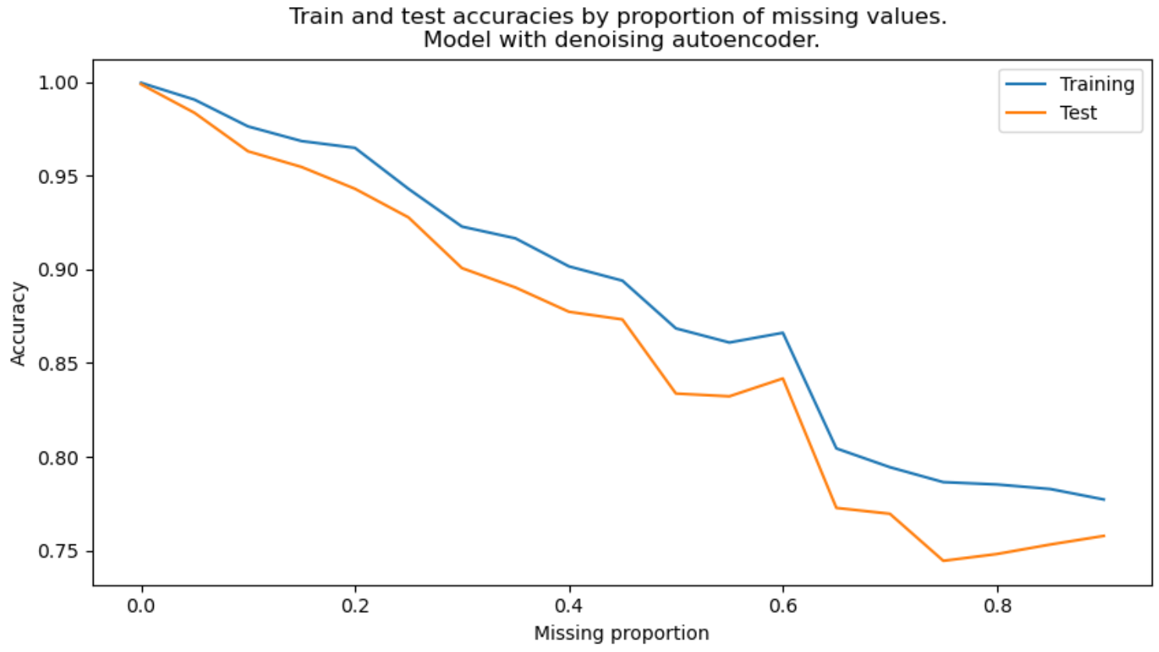
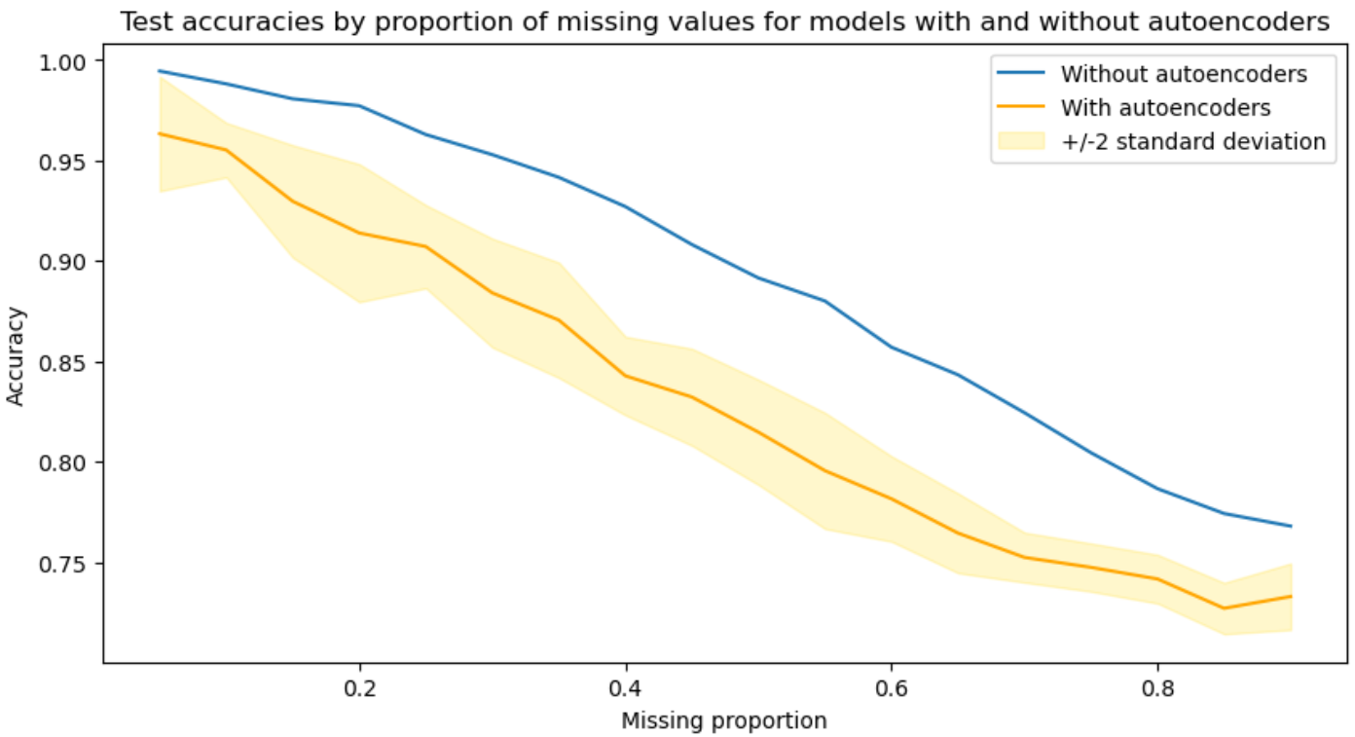
Results: Mushroom all variables
LightGBM without denoising autoencoder:
Missing values were filled with the median.
LightGBM with denoising autoencoder:
Comparison with and without autoencoder.

